Slide 1
Direct Energy Amplified Threat Hunting System for Targeting Asteroids and Rocks
William, Eric, Jeff, Wei

Slide 2
DEATHSTAR
William, Eric, Jeff, Wei

Slide 3
Program Management Approach
Gov’t Team(s), FFRDC, SETA, SE&I
EVM will track cost and schedule performance.
Man power | FTE
Gov’t | 2
FFRDC | 2
SETA | 1
SE&I | 2

Slide 4
Risks
Schedule – (4, 4) – Monitor progress and mitigate delays by adding incentives/bonuses for meeting/beating timeline
Cost – (5, 1) – Mitigate risks by perform regular cost estimates to ensure adequate funding
Engineering Talent – (3, 2)
Cyber security – (1, 2)
Funding – (2, 5)
5
LIKELIHOD
4
S
3
E
2
F
1
Cy
C
1
2
3
4
5
CONSEQUENCES

Slide 5
Acquisition Plan (SCHEDULE)
Plan
Market research
Industry month
Four Draft Request for Proposal
Final RFP release!
Source selection / Down select:
Maturity, feasibility, and cost.
Design validation in relevant environment
CPIF award to two contractors
Incentive schedule performance
Notes:
Market research (Request for Information)
Industry month (Presentation & 1-on-1s)
Draft Request for Proposal (DRFP, how many?)
Final RFP release!
5. Component and/or breadboard validation in relevant environmentFidelity of breadboard technology increases significantly. The basic technological components are integrated with reasonably realistic supporting elements so they can be tested in a simulated environment. Examples include “high-fidelity” laboratory integration of components.Results from testing laboratory breadboard system are integrated with other supporting elements in a simulated operational environment. How does the “relevant environment” differ from the expected operational environment? How do the test results compare with expectations? What problems, if any, were encountered? Was the breadboard system refined to more nearly match the expected system goals?

Slide 6
Acquisition Plan (SCHEDULE)
Schedule
Tech development
Prototype
EMD
Production
Jan | Feb | Mar | Apr | May | Jun | Jul | Aug | Sep | Oct | Nov | Dec
Market Research
Industry Month
Four Draft Request for Proposal
Final RFP Release
Source Selection / Down Select
Contract Release
Notes:
Market research (Request for Information)
Industry month (Presentation & 1-on-1s)
Draft Request for Proposal (DRFP, how many?)
Final RFP release!
5. Component and/or breadboard validation in relevant environmentFidelity of breadboard technology increases significantly. The basic technological components are integrated with reasonably realistic supporting elements so they can be tested in a simulated environment. Examples include “high-fidelity” laboratory integration of components.Results from testing laboratory breadboard system are integrated with other supporting elements in a simulated operational environment. How does the “relevant environment” differ from the expected operational environment? How do the test results compare with expectations? What problems, if any, were encountered? Was the breadboard system refined to more nearly match the expected system goals?

Slide 7
Program Office Estimate (POE)

Slide 8
Spec Tree
Prototype
SEPM
Direct Energy Apparatus
Network
Control
SE
PM
Gas Reservoir
Power
Mirror
Housing
Getter
Cathode
Anode

Slide 9
Request for Proposal
WBS # | WBS Element | Statement of Work
1.0 | Prototype
1.1 | SEPM
1.1.1 | Systems Engineering | The Conctractor shall develop a ConOps (CDRL A001), perform Requirement and Architecture analysis (CDRL A002), perform Detailed Design and Implementation Analysis (CDRL A003), perform Integrated Test & Validation (CDRL A004), perform System Verification & Validation (CDRL A005).
1.1.2 | Program Management | The Contractor shall manage the program to minimize cost and and meet schedule and performance objectives.
1.2 | Directed Energy Apparatus Prototype | The Contractor shall produce a prototype Directed Energy Apparatus that support 0-20 MegaWatts of energy.
1.2.1 | Gas Resevoir | The Contractor shall produce a Gas Resevoir component that supports 0-20 MegaWatts of energy.
1.2.2 | Power | The Contractor shall produce a Power component that supports 0-20 MegaWatts of energy.
1.2.3 | Mirror | The Contractor shall produce a Mirror component that supports 0-20 MegaWatts of energy.
1.2.4 | Housing | The Contractor shall produce a Housing component that supports 0-20 MegaWatts of energy.
1.2.5 | Getter | The Contractor shall produce a Getter component that supports 0-20 MegaWatts of energy.
1.2.6 | Cathode | The Contractor shall produce a Cathode component that supports 0-20 MegaWatts of energy.
1.2.7 | Annode | The Contractor shall produce a Annode component that supports 0-20 MegaWatts of energy.
1.3 | Prototype Test | The contractor shall perform a comprehensive test to measure the capaibility of the prototype.
1.3.1 | Power Test | The contractor shall conduct a Power (Energy) Test that measures Watts and Duration (CDRL A006).
1.3.2 | Energy Usage Test | The contractor shall conduct a Energy Usage Test that measures power requirement of the prototype (CDRL A007).
1.3.3 | MTTRF Test | The contractor shall conduct a MTTRF Test that measures the duration to Restore function to the system (CDRL A008).

Slide 10
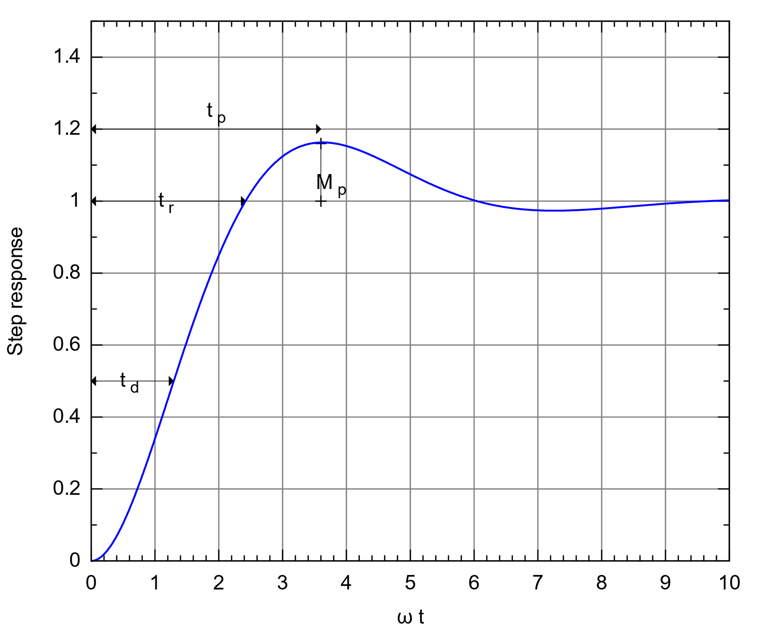
Request for Proposal
Spec
Direct Energy Apparatus
Power: 0 to 20 MW
Duration: Up to 15 years
Control System
Rise time:
Overshoot
Steady state error
Network
Cybersecurity
Latency
Notes:
Getter Substance used to remove gas from vacuum.
Full Mirror
Gas Reservoir
Getter
Heat sink
Rise timeRise time refers to the time required for a signal to change from a specified low value to a specified high value.
Typically, these values are 10% and 90% of the step height.Overshoot
Overshoot is when a signal or function exceeds its target. It is often associated with ringing.Settling timeSettling time is the time elapsed from the application of an ideal instantaneous step input to the time at which the output has entered and remained within a specified error band.Delay-timeThe delay time is the time required for the response to reach half the final value the very first time.^{[1]}Peak timeThe peak time is the time required for the response to reach the first peak of the overshoot.^{[1]}Steady-state error2003's Instrument Engineers' Handbook defines the steady-state error of a system as "the difference between the desired final output and the actual one" when the system reaches a steady state, when its behavior may be expected to continue if the system is undisturbed.^{[2]}

Slide 11
Request for Proposal
Evaluation Criteria
Research and scientific work
Project team and qualifications
References about prior experience
Financial capacity
Preliminary design and result
Labor and fees
Submission Requirements
Research and scientific work
List all project team qualifications
Five references about prior experience
Financial capacity report
One prototype design and preliminary
experimental data
Labor and fees

